Slide 1
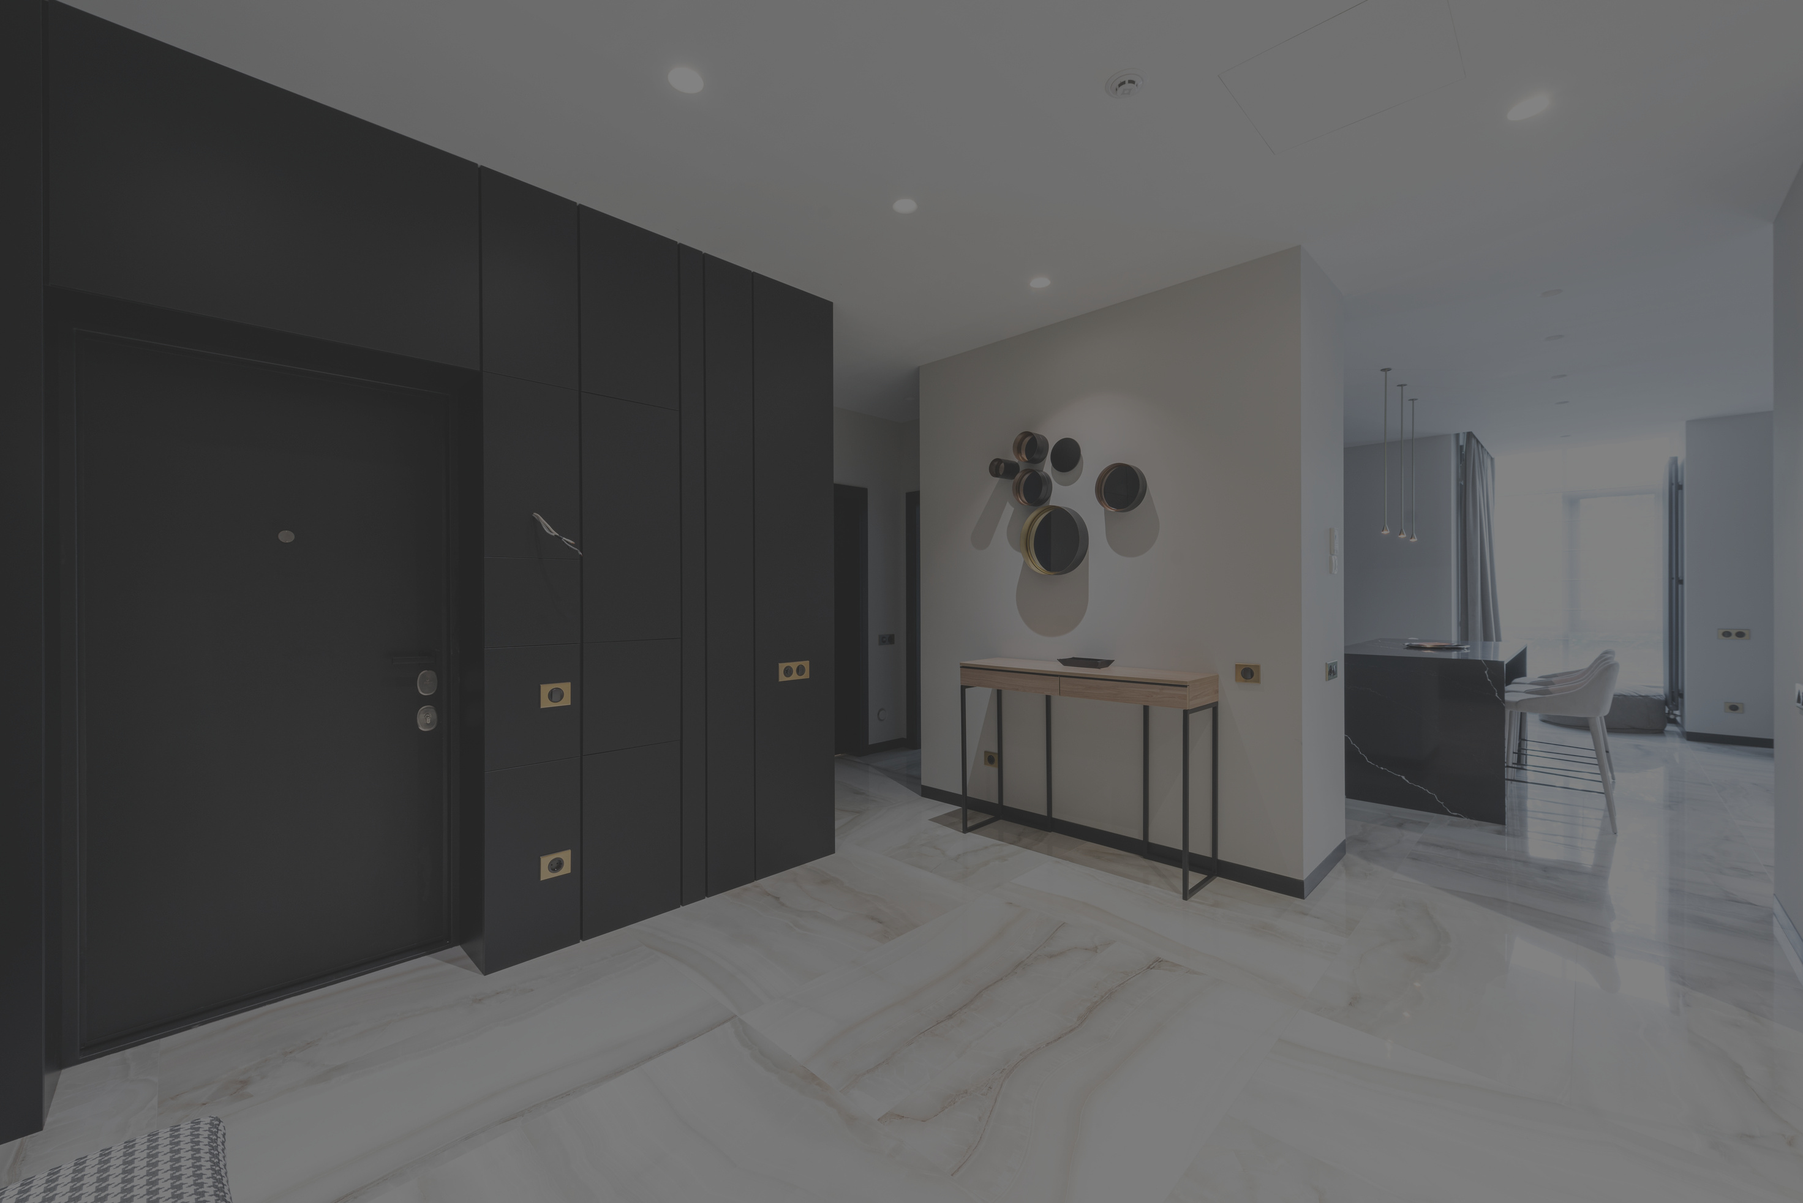
FASHION SALES

Slide 2
PROBLEMS
High pricing
Customer preference
Marketing challenges

Slide 3
SOLUTION
Start low pricing sales to gain customers and popularize our business
Mostly youth prefer western fashion
Engage with customers through social media and email-marketing

Slide 4
UNIQUE VALUE POPOSTION
We sales good quality products
We will give exceptional customer

Slide 5
UNFAIR ADVANTAGES
Keeps records of customer s and give lucky draw
We will give time to time delivery without fail

Slide 6
CUSTOMER SEGMENTS
Target customer
Advertise about our company
Customer feedbacks
Those who engage more in our advertisement will provide more offers

Slide 7
EXISTING ALTERNATIVE
We can sales gifts and flower bouquet

Slide 8
KEY METRICS
KEY METRICS
Trending forecasting-staying ahead of fashion trends by prediction future styles, fabrics color palettes

Slide 9
CHANNELS
Social media
Letting early customers to share and spread our news about opening of business

Slide 10
EARLERY ADOPTERS
Youths
Actress and Actor

Slide 11
COST SRTUCTURE
List your fixed and variable cost
Customer acquisition cost
Distribution cost
Hosting
People etc...

Slide 12
REVENUE STRUCTURE
List your sources of revenue
Revenue model
Life time value
Revenue
Gross margin

Slide 13
THANK YOU

